Slide 1

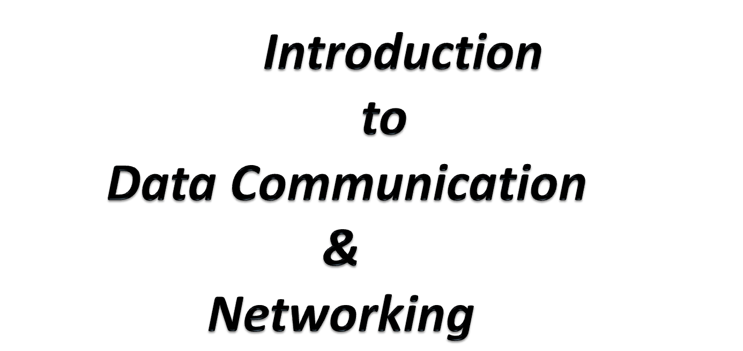

Slide 2
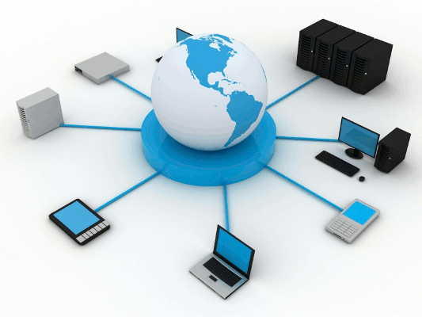
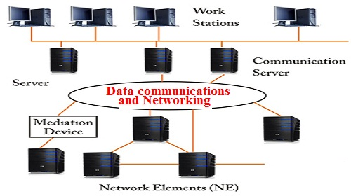

Slide 3
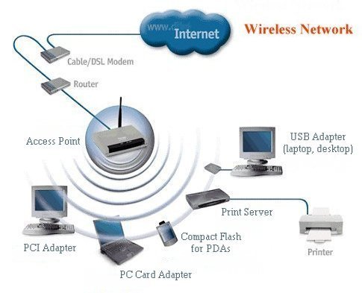
DATA COMMUNICATION

Slide 4
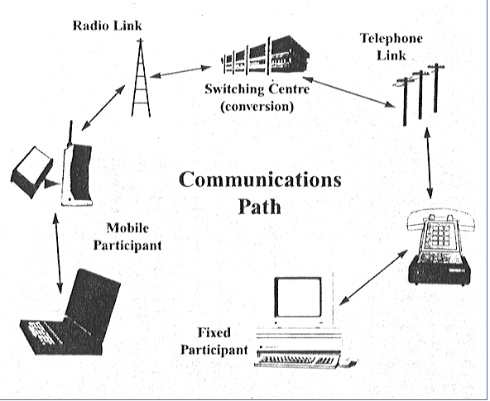
DATA COMMUNICATION

Slide 5
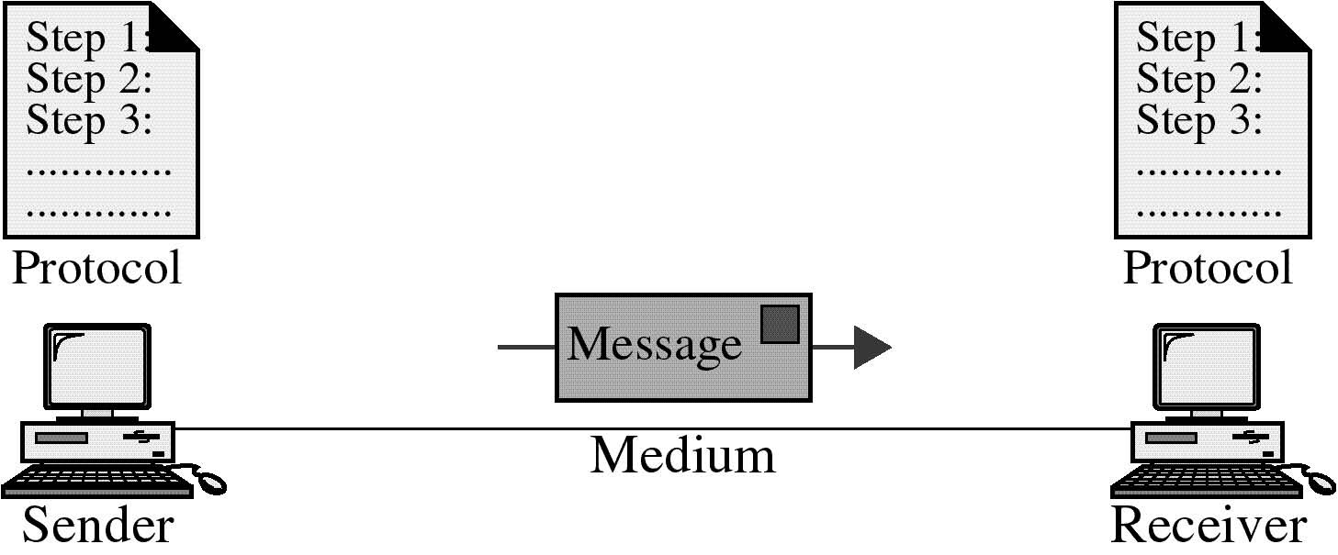
Data Communication are the exchange of data between two devices
via some form of transmission medium such as a wire cable.
For this data communications to occur , the communicating devices
must be a part of a communication system made up of a combination
of hardware and software.

Slide 6
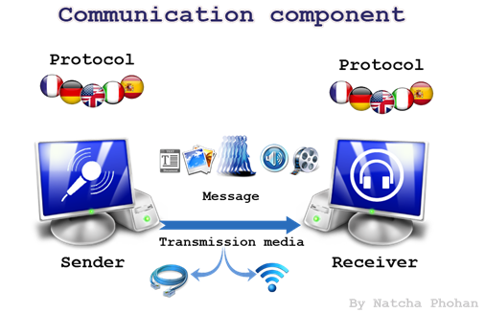

Slide 7
Components of Data Communication System:-
Message- It is the information or data to be communicated.
Sender - Device that sends the data message.
Receiver- Device that receives the message.
Transmission Medium- Physical path by which a message
travels from sender to receiver.
Protocol- Set of rules that govern data communication.
A protocol defines what is communicated, how it is communicated, and when it is communicated.

Slide 8
Protocol and the key elements of protocol
Syntax- Refers to the structure or format of the data, i.e. the order
in which they are presented.
Ex: First 8 bits of data might be address (sender), last 8 bits of data might be
address (receiver) and the rest of the stream, the message itself.
Semantics- Refers to the meaning of each section of bits.
Ex: How is the particular pattern to be interpreted?
Does an address identify the route or final destination.
Timing- Refers to the following characteristics:
i) when data should be sent.
ii) how fast they can be sent.
iii) how much data should be sent.

Slide 9
Fundamental characteristics of Data Communications:
Delivery- System must deliver data to the correct
destination.
Accuracy- System must deliver data accurately.
Timeliness- System must deliver data in a timely manner.
Jitter- Refers to the variation in the packet arrival
time.

Slide 10
Data Representation
Text- Represented as a bit pattern, sequence of 0’s and 1’s.
Numbers-Also represented by bit patterns.
Images- Composed of matrix of pixels.
Each pixel is assigned a bit pattern.
Audio - Recording or broadcasting of sound or music.
Video - Recording or broadcasting of a picture or
movie.
It can be a combination of images.

Slide 11
DATA FLOW

Slide 12
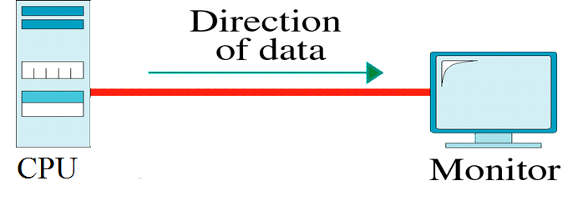
Simplex
Communication is unidirectional.
One of the two devices can transit, and the other can receive.
Example : Keyboard can only introduce input; the monitor can only
accept output.

Slide 13
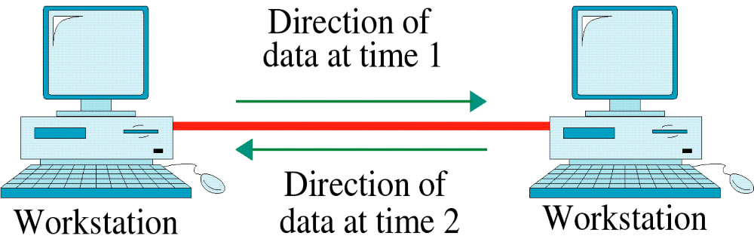
Half Duplex
Each station can both transit and receive, but not at the same time.
When one is sending, the other can only receive and vice-versa.
Walkie -Talkie is an example.

Slide 14
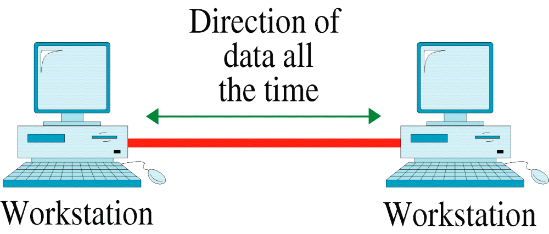
Full Duplex
Both stations can transmit and receive simultaneously.
Capacity of the links are shared by the signals.
Example: Telephone network, as over telephone both parties can
talk and listen at the same time.

Slide 15
NETWORKS

Slide 16
A network is set of devices(often referred to as nodes) connected by communication links.
A node can be a computer, printer or any other devices capable of sending and/or receiving data generated by the nodes on the network.

Slide 17
Network Criteria
Performance- Measured by transit time and response time.
Transit time: Amt of time required for a message to travel from one device to another.
Response Time: Elapsed time between enquiry and response.
Reliability- Measured by frequency of failure and the time
the link takes to recover from failure.
Security- Protecting data from unauthorized access,
damage, etc.

Slide 18
PHYSICAL STRUCTURES

Slide 19
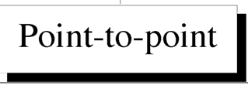
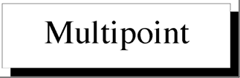
Type of Connection
A link in a network is a communication pathway that transfers data from one device to another.
There are two types of possible connections:-

Slide 20
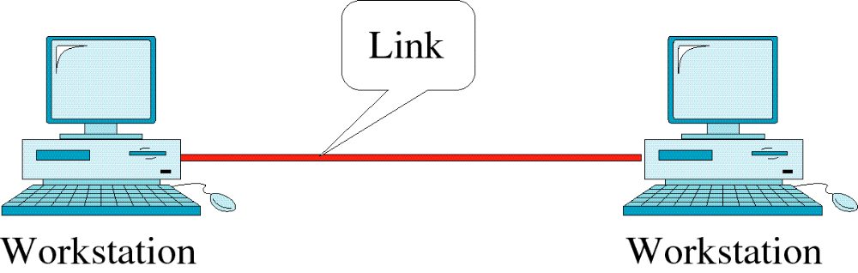
Point-to-Point Line Configuration
Provides a dedicated link between two devices.
Entire capacity of the link is reserved for transmission between
those two devices.
Example: Controlling the television channels by remote control.

Slide 21
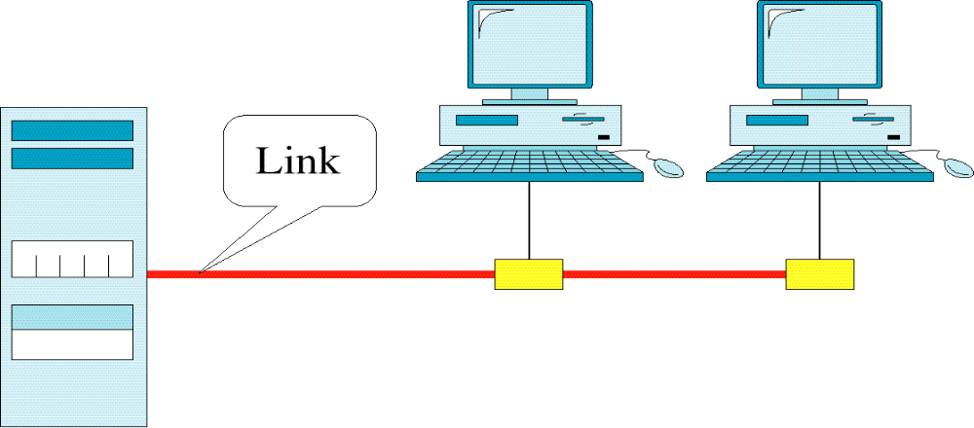
Multipoint Line Configuration
A multipoint or multidrop connection is one in which more
than two specific devices share a single link.
Here the capacity of the channel is shared either spatially or in a
timeshared manner.

Slide 22
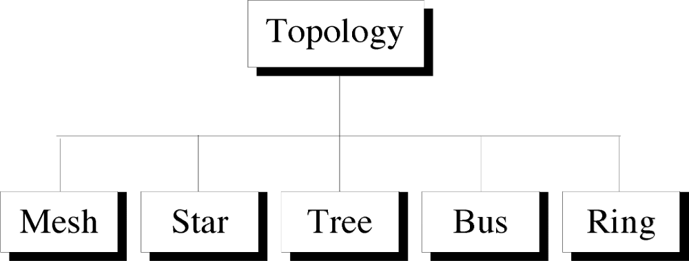
Physical topology refers to the way in which a network is
laid out physically.
Two or more devices connect to a link.
Two or more links form a topology.

Slide 23
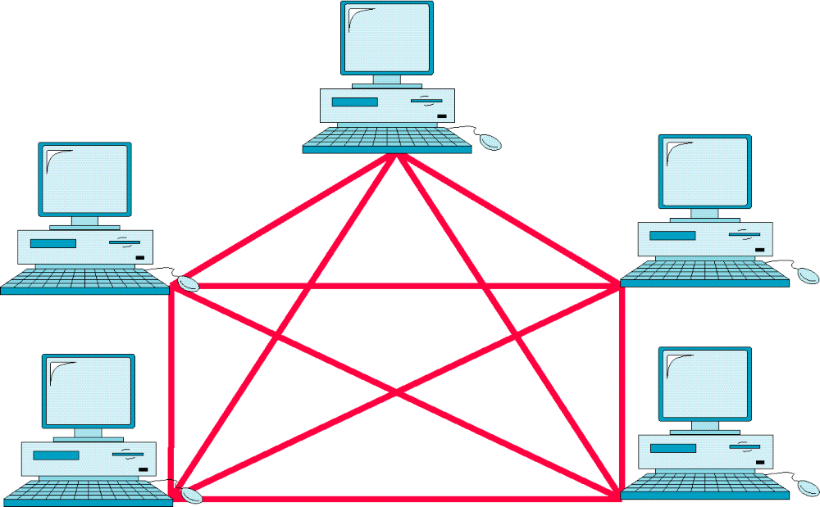
Mesh Topology

Slide 24
FEATURES:-
Every device has a dedicated point to point link to every
other device.
Each node is connected to every other n-1 nodes in the
network.
(Considering n nodes in the network)
So we need n(n-1) links in a mesh network.
To accommodate that many links, every device on the
network must have n-1 input/output ports.

Slide 25
ADVANTAGES:-
Each connection carries its own data load, thus eliminating traffic
problems.
If one link becomes unusable, it does not disturbs the whole system.
Provides privacy and security due to the presence of dedicated link.
For point-to-point links fault isolation is easy.
DISADVANTAGES:-
Huge amount of cabling is required.
Lots of input-output ports are required.
EXAMPLE:-
Connection of telephone regional offices.

Slide 26
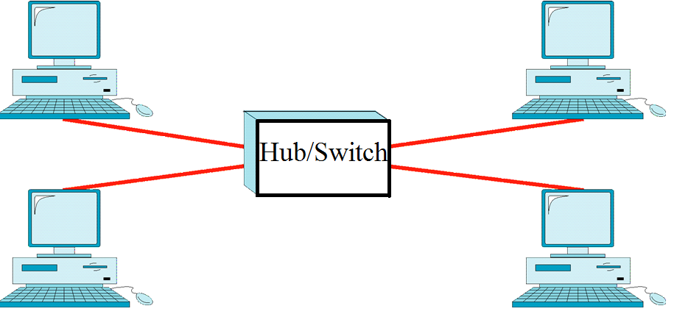
Star Topology

Slide 27
FEATURES:-
Here each device has a dedicated point to point link to a central controller hub/switch.
Here the controller acts as an exchange. Here each device send the data to the controller , which then relays it to the other connected device.
ADVANTAGES:-
Less expensive than mesh topology.
Each device needs only one link and one I/O device to be connected to
the controller.
Far less cabling is required.

Slide 28
If a link fails, only that link is effected. The whole system remains
unaffected.
Easy fault isolation.
DISADVANTAGE:-
Dependency of the whole topology on the single point hub/switch.
EXAMPLE:-
Used mostly in LANs

Slide 29
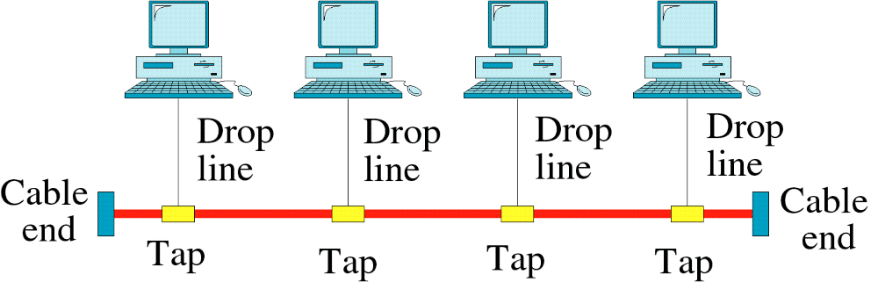
Bus Topology

Slide 30
FEATURES:-
A Bus topology is a multi-point connection.
Here one long cable acts as a backbone to link all the devices in the network.
Here nodes are connected to the bus line by drop lines and taps.
A tap is a connector that either splices into the main cable or punctures the sheathing of the cable to create contact with metallic core.
Here the signal travels along the backbone.

Slide 31
ADVANTAGE:-
Installation is easy.
Less cabling is required as compared to mesh and star topologies.
DISADVANTAGE:-
Fault Isolation.
Adding up large number of nodes is not possible, as quality of the signal
degrades, as it travels longer.

Slide 32
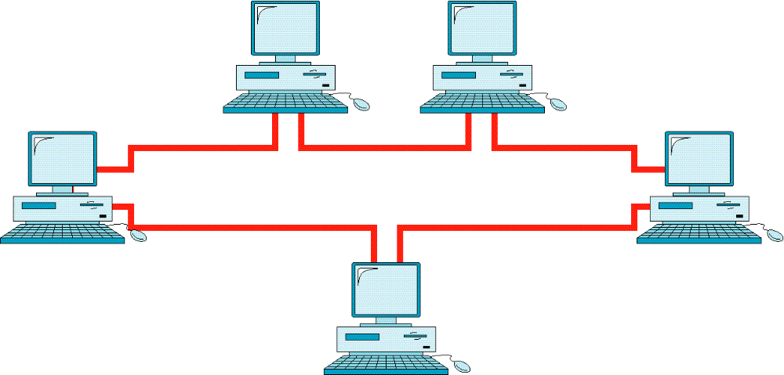
Ring Topology

Slide 33
FEATURES:-
Here each device has dedicated point-to-point connection with only
two devices on either side of it.
The signal passes along in one direction until it reaches its destination.
Each device in the ring incorporates a repeater, to regenerate the
signal and pass it on. (For a bigger ring).
Signal travelling is uni-directional.
ADVANTAGES:-
Easy to install and reconfigure.
Fault isolation is easy.

Slide 34
DISADVANTAGE:-
Unidirectional traffic is sometimes a disadvantage.
A break in the ring can disable the entire network.
EXAMPLE:-
In bigger networks.

Slide 35
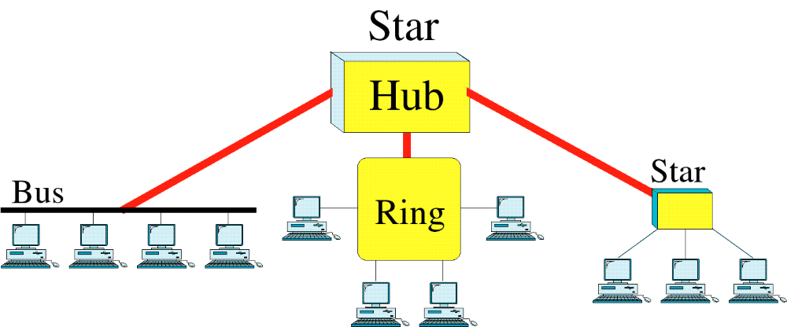
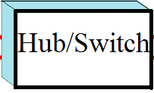
Hybrid Topology

Slide 36
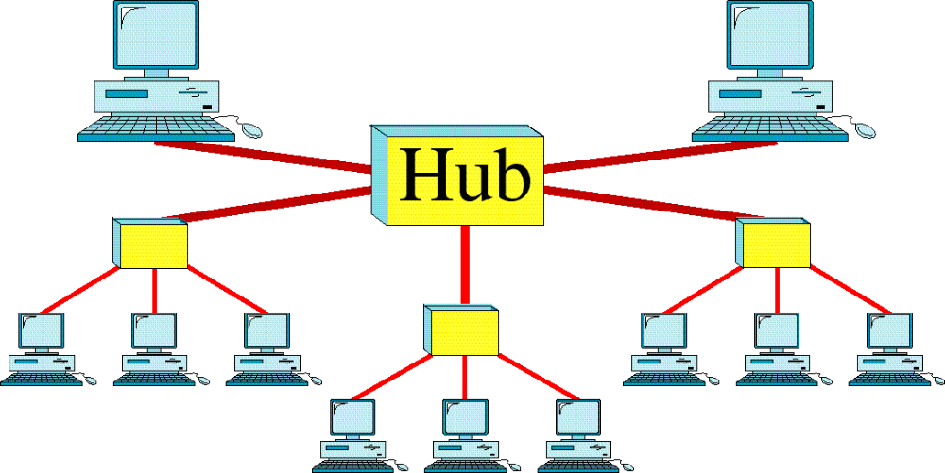
Tree Topology

Slide 37
NETWORK CATEGORIES

Slide 38
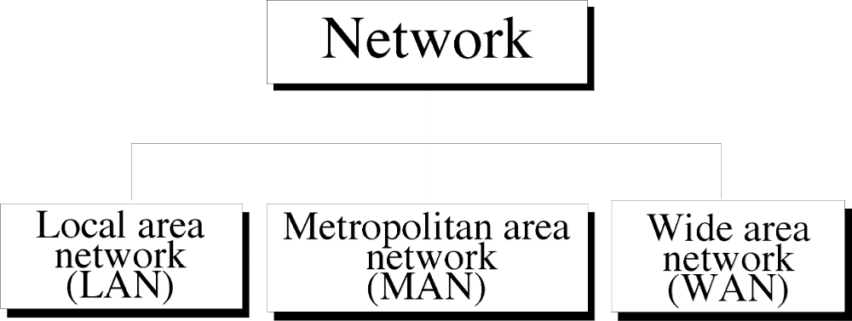
The primary categories of networks are:-
WCB/McGraw-Hill
© The McGraw-Hill Companies, Inc., 1998

Slide 39
LAN
Local Area Networks are generally privately owned networks.
Designed to connect devices in a single office, building or
campus.
Limited to few Kilometers.
Designed to allow resources (both hardware and software
or data) to be shared between personal computers.
Most common LAN topologies are Bus, Ring and Star
topologies.

Slide 40
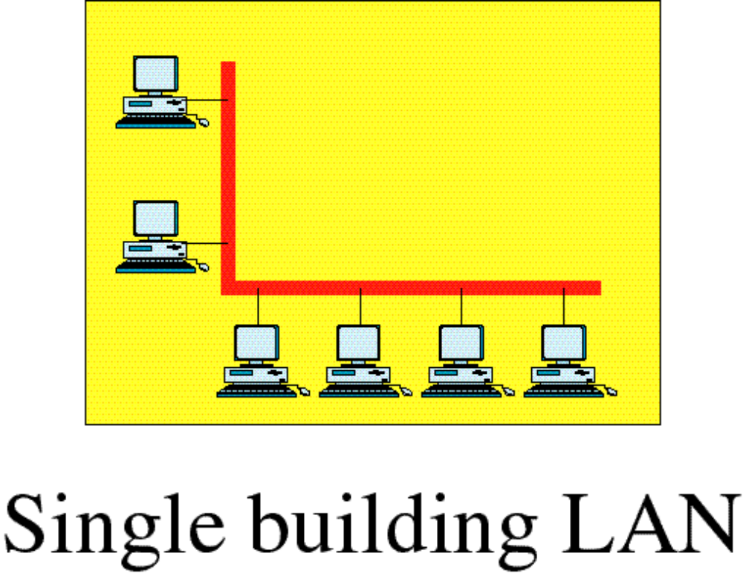
Local Area Network

Slide 41
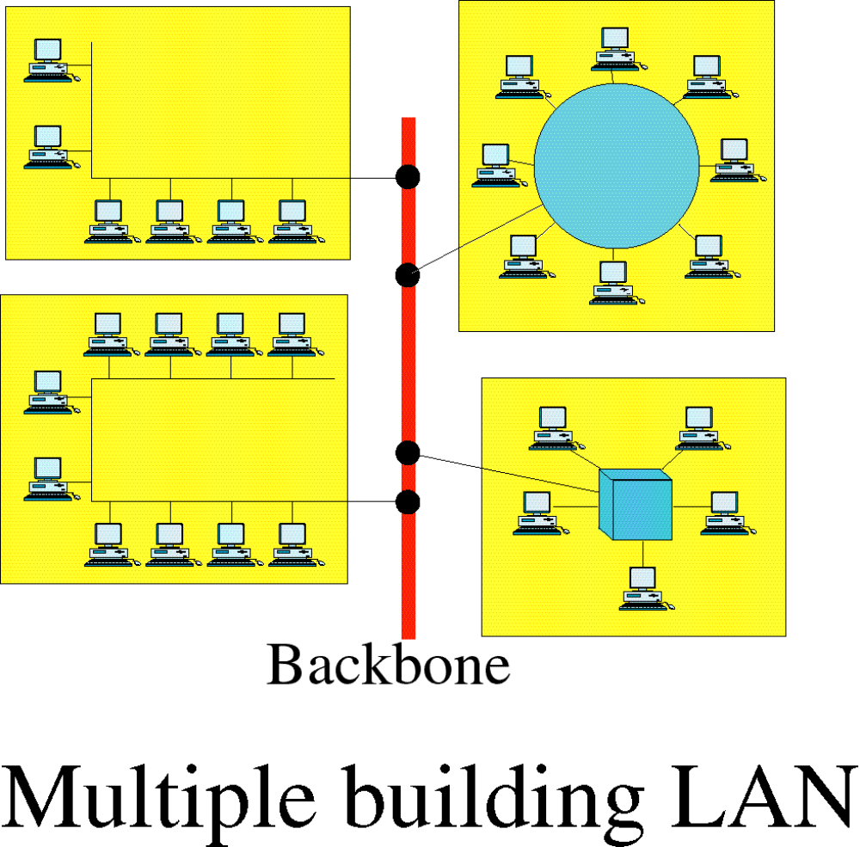
Local Area Network

Slide 42
MAN
Metropolitan Area Network normally covers the area inside
a town or a city.
Size of a MAN is between a LAN and a WAN.
The best known example is a cable television network
available in the cities.
Recent developments in wireless Internet Access is also
another example of MAN.

Slide 43
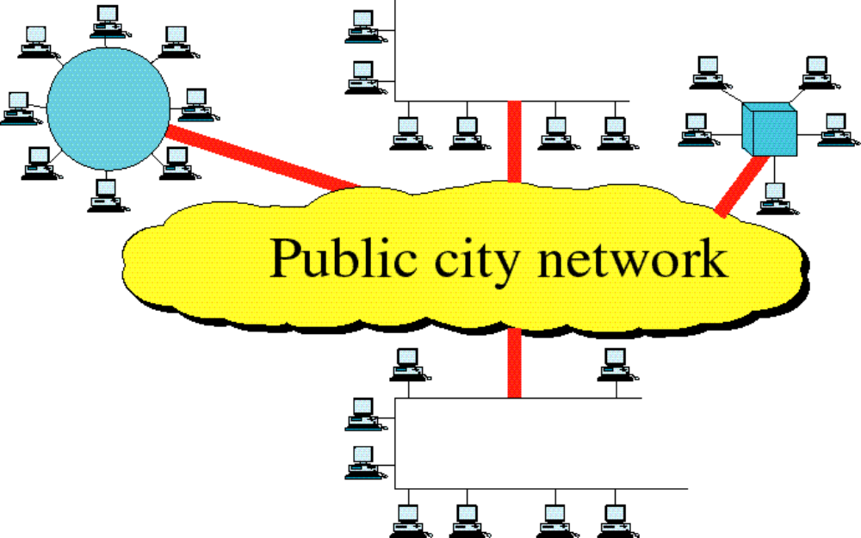
Metropolitan Area Network

Slide 44
WAN
Wide Area network provides long distance transmission of data, image,
audio, video, etc.
There are two types of WAN connection: Switched WAN and
Point-to-Point WAN.
Switched WAN’s connect the end systems, which usually comprise a
router , that connects to another LAN or WAN.
Point-to-Point WAN is normally a leased line from a telephone or a
cable TV provider that connects a home computer or a small LAN to
an ISP(Internet Service Provider).

Slide 45
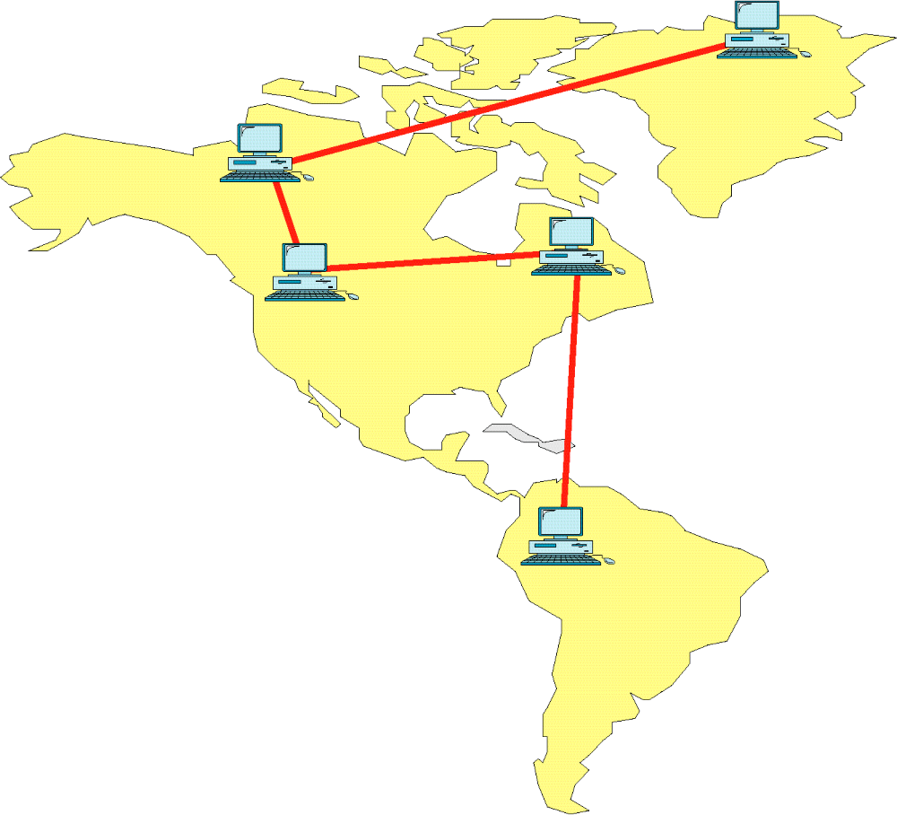
Wide Area Network

Slide 46
PAN
A personal area network - PAN - is a computer network organized
around an individual person.
Personal area networks typically involve a mobile computer, a
cell phone and/or a handheld computing device.
You can use these networks to transfer files including email and
calendar appointments, digital photos and music.
Personal area networks can be constructed with cables or be
wireless.
USB often act as a wired PAN, while wireless PANs typically use
Bluetooth or sometimes infrared connections.

Slide 47
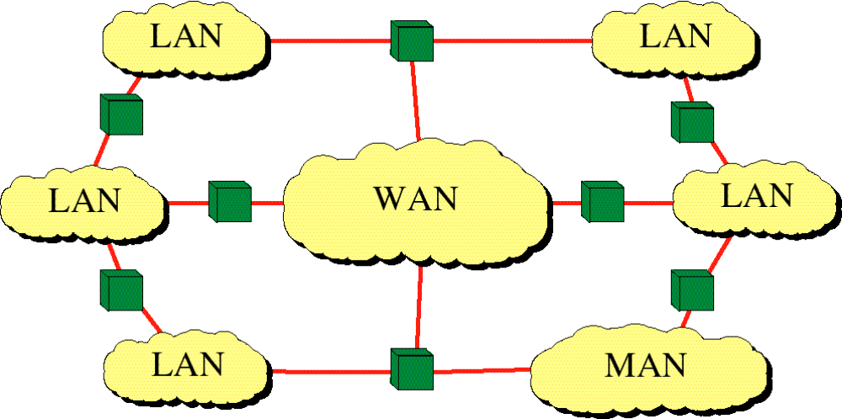
Internetwork
(Internet)
© The McGraw-Hill Companies, Inc., 1998

Slide 48
Internet (With capital I) –
Collaboration of more than hundreds and thousands of interconnected network.
internet (With small i )-
It is two or more networks that communicate with each other.

